Slide 1


What the DCC Can Do For You
DCC Data Management Roadshow
9th November 2011
Cambridge

Slide 2
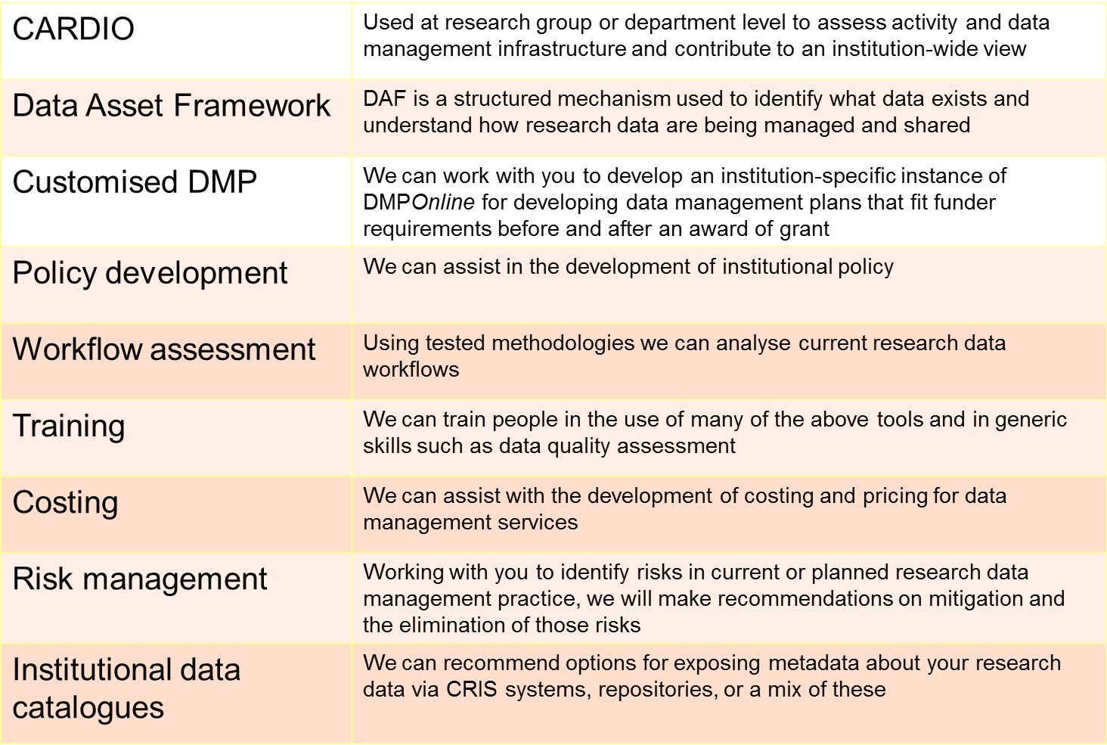
As promised earlier…
Notes:
Some people are interested in learning more about shared services in the cloud. HEFCE have recently invested heavily in a pilot to develop and test shared research data management services and tools in the cloud. The DCC will be working to support this activity over the coming months.

Slide 3
Who are you?
Researcher(s)
Research support officers / project staff
Lab technicians
Librarians / Data Centre staff
Faculty ethics committees
Institutional legal/IP advisors
FOI officer / DPA officer / records manager
Computing support
Institutional compliance officers
Funders
Archive / long-term data repository
Senior management
Others...
Notes:
Based on the pre-event questionnaire that most of you completed, it seems that the majority of you have some institutional and/or funding body requirements to manage your research data. Some indicated that there were no research data management requirements affecting their work, but it is important to note here that many institutional codes of practice (e.g., code of good research practice) assume that good data management is being undertaken by staff and students.

Slide 4
Categories of Service
Assessing Need
Delivering Support
Developing Strategic Institutional Research Data Management Support
Policy
Advocacy
Planning
Tools
Training
Each may be further sub-divided by associated tool or service
Notes:
These aims resonate with many of your own aims and objectives (based on pre-event questionnaire).

Slide 5


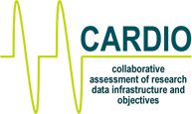

DCC TOOLS

Slide 6

IN BRIEF
The Data Asset Framework provides a methodology and online tool to identify research data assets and find out how they are being managed. This information will enable institutions to develop a data strategy so their assets are preserved and remain accessible in the long term. It is usually applied at research group / department level to ensure the scope is manageable.
URL: http://www.data-audit.eu

Slide 7
What can the DCC do for you?
Give advice during the investigation process as necessary;
Assist the institution to progress findings into concrete next steps, approved and supported by senior management.
Provide support and advice to help the institution define the scope/context for an investigation. This could include identifying a suitable group, constructing surveys / interview frameworks, drafting approaches for participation, running events/meetings to help get key stakeholders onside, etc;

Slide 8
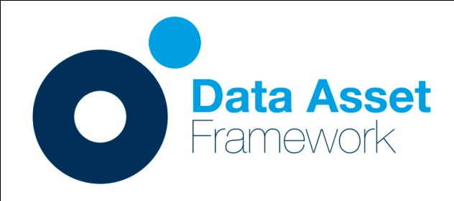
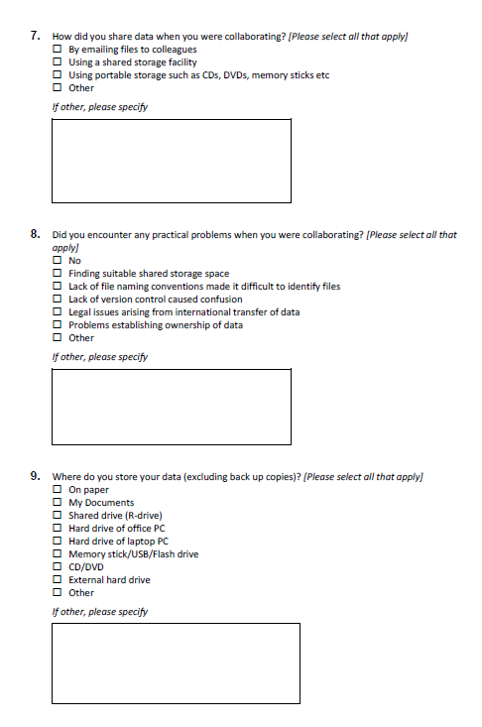
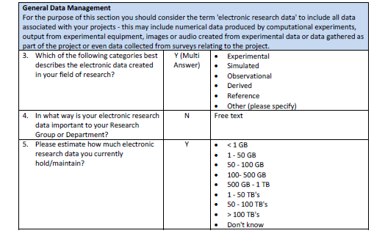
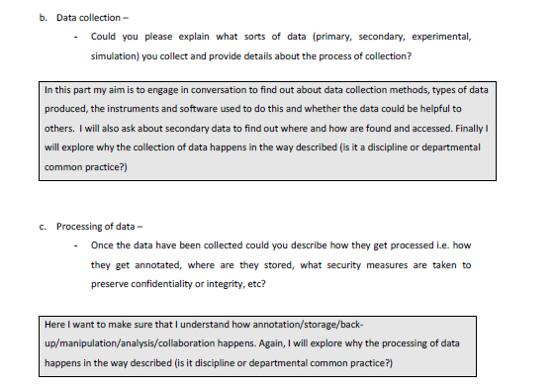
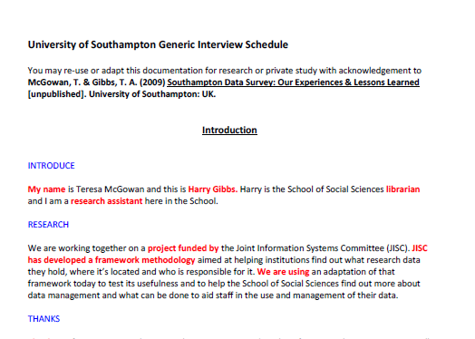



Implementation guide
Data management questionnaires and interview frameworks to reuse
Practical guidance and lessons learned from DAF users
http://data-audit.eu/docs/DAF_Implementation_Guide.pdf

Slide 9
IN BRIEF
DMP Online is the DCC's web-based data management planning tool. It allows you to build and edit DMPs according to the requirements of the major UK funders.
The tool also contains helpful guidance and links for researchers and other data professionals. The structure of the tool is based on the DCC’s Checklist for a Data Management Plan.
URL: http://www.dcc.ac.uk/dmponline
Notes:
In the pre-event questionnaire, several of you indicated that you wanted to be able to learn about tools to help you improve your data management activity. DMP Online can help you to think through the issues and illustrate where you may need input and support from other stakeholders.

Slide 10
What can the DCC do for you?
Development of template data management plans (presented through DMP Online);
Institution-specific guidance on how to develop a plan (embedded into DMP Online and/or a hardcopy customised How-To guide);
A locally branded interface to the central instance of DMP Online (more ambitious);
Assistance to help institutions develop their data management planning services, e.g. to support DMP writing and/or review plans prior to submission.

Slide 11
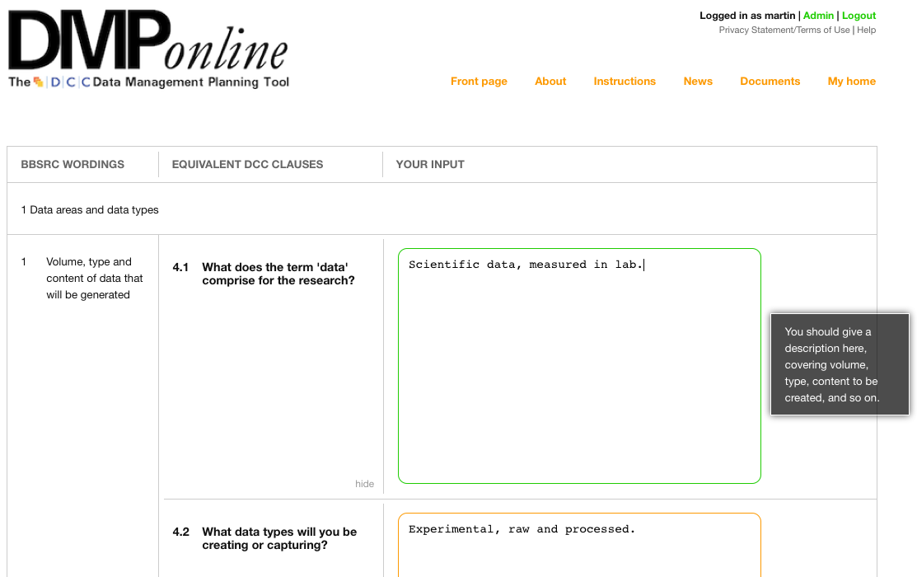

Slide 12
IN BRIEF
CARDIO is an online tool which helps departments or research groups to identify and communicate their current data management capabilities, and subsequently identify coordinated pathways for future enhancement via a dedicated knowledge base.
CARDIO emphasises a collaborative, consensus-driven approach, and enables benchmarking with other groups and institutions.
URL: http://cardio.dcc.ac.uk/
Notes:
Many of you indicated in the pre-event questionnaire that you were looking for tools to help you make the case for research data management at your institution and to be more proactive about recommending specific areas for improvement. CARDIO helps to highlight where improvement is needed and helps to show where investment of resource may have the best impact.

Slide 13
What can the DCC do for you?
Promote institutional discourse and a collaborative approach to data management problem solving;
Offer reassurance of infrastructural capacity and satisfaction of data management planning commitments;
Highlight priority areas for resource investment, or areas where investment will have particular impact;
Relate local data contexts to the wider world of data management via a central evidence base;
Facilitate engagement with senior management over data management responsibilities and gaps.

Slide 14
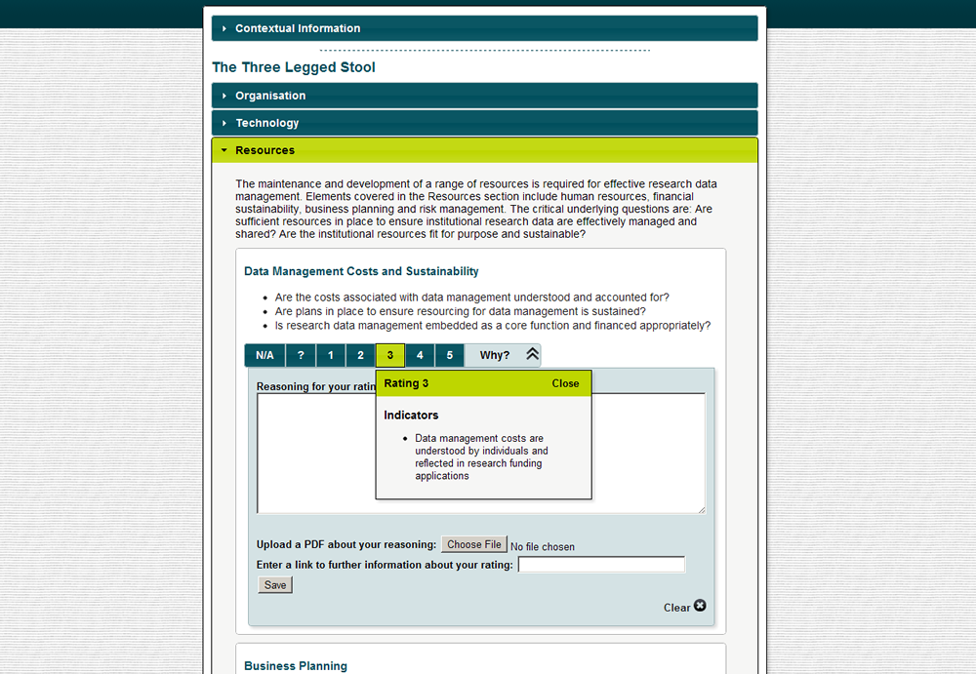

Slide 15
IN BRIEF
DRAMBORA is an audit methodology and tool for identifying and planning for the management of risks which may threaten the availability and/or usability of content in a digital repository or archive.
URL: http://www.repositoryaudit.eu

Slide 16
What can the DCC do for you?
Help establish a systematic internal understanding of organisational facets and of interrelationships between goals, functions, systems and personnel;
Introduce issues of risk management into the business culture of the organisation;
Highlight in comprehensible terms areas of success and shortcomings;
Prepare the institution in practical (e.g. documentary) and cultural terms for future external audit processes.

Slide 17
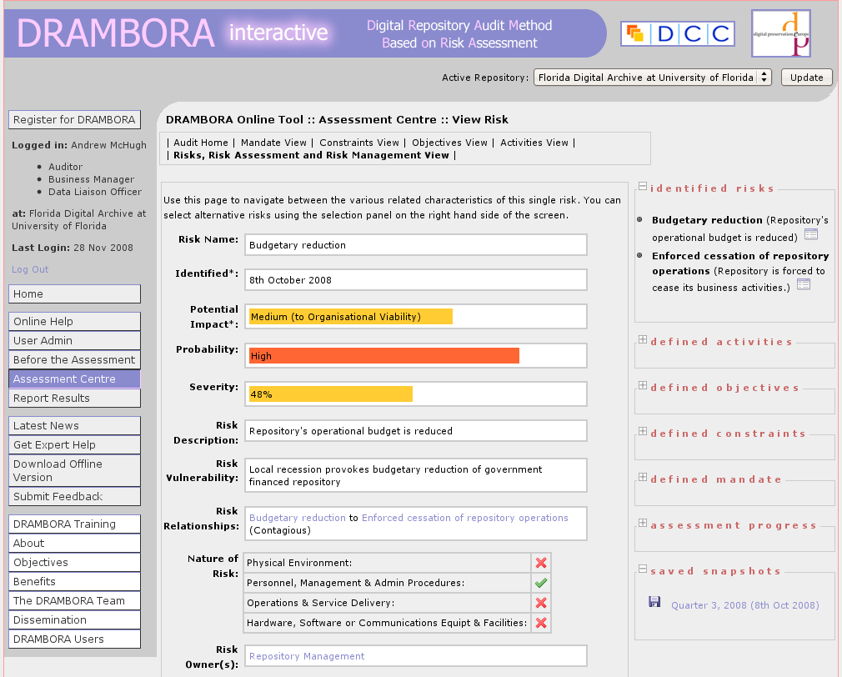

Slide 18
SERVICES
Policy
Strategy
Training
Other services...

Slide 19
Policy (i)
The DCC has a number of guidance resources related to research data policy. We can guide institutions on their requirements to manage/share data, and offer practical steps to help them develop data policies by:
Providing templates and examples to demonstrate what aspects could be incorporated into a data policy;
Coordinating / contributing to meetings of relevant stakeholders to ensure all activities and perspectives are addressed;
Reviewing and feeding back on draft policies;
Assisting with communications to launch and implement the policy.
Notes:
Several of the pre-event questionnaire respondents indicated that they are aiming to develop institutional policies and strategies. The DCC can help you with these endeavours.

Slide 20
Policy (ii)
Primary benefits of developing a data policy:
Compliance with funder guidelines, e.g. the EPSRC expectation that HEIs have a RDM roadmap in place by May 2012, and be fully compliant by May 2015;
Assuring the good conduct of research in line with Research Integrity guidelines (see Research Councils UK / UK Research Integrity Office docs);
Clarity for researchers and demonstrable institutional commitment for RDM;
The prestige of joining a small but growing group of leading institutions with a data policy: http://www.dcc.ac.uk/resources/policy-and-legal/institutional-data-policies

Slide 21
Policy (iii)
What can the DCC do for you?
support policy development;
run workshops to support the take-up and embedding of the new policy;
promote the institution's policy with the RDM community and research funders.
Notes:
Many respondents to the pre-event survey were keen to develop policies that adhere to funding body requirements. The DCC has developed policy pages that include an at-a-glance table of research council and funding body policies relating to data management; and also provides links to examples of institutional policies and other useful resources.
http://www.dcc.ac.uk/resources/policy-and-legal

Slide 22
Strategy (i)
What can the DCC do for you?
We offer a half-day workshop in which key stakeholders from an institution (e.g. librarians, senior IT staff, research administration, repository staff, researchers, etc) convene to discuss and develop an institutional strategy for RDM.
Benefits:
Coherence across service providers and agreed direction for RDM services;
Ability to reference strategy / commitment to RDM (the University of Oxford’s progress may be a useful example of this - http://www.admin.ox.ac.uk/rdm);
A move towards more efficient management of data.
Notes:
Many respondents to the pre-event questionnaire were looking for tips on maiing the case to senior management. The DCC’s recent briefing paper may be a good place to start. There are some copies here and you can also access it online at http://www.dcc.ac.uk/resources/briefing-papers/making-case-rdm.
Several of you wanted to be able to advise researchers on how to develop a data management plan and how to cite data. The recently published DCC How-To guides on these topics may be a good resource for researchers and research support staff.
See http://www.dcc.ac.uk/resources/how-guides/
Some pre-event questionnaire respondents indicated that they’d like to be able to provide researchers with local access to tools and support. The JISC-funded Incremental project offers a useful starting point and model for pulling together and re-targeting existing institutional resources.
See http://www.dcc.ac.uk/projects/incremental

Slide 23
Strategy (ii)
Through practical breakout sessions, senior DCC staff will lead and mediate discussion to help the institution determine its priorities and define practical next steps.
These could include the development of infrastructure (e.g. data repositories), new services (e.g. DMP support), policy development, improved guidance or data management training provision.
Suggested actions will depend on gaps/areas for improvement as perceived by the institution.

Slide 24
Training (i)
We offer a variety of training courses, from the DC101 introduction to data management, to Tools of the Trade courses which give practical overviews and hands-on exercises using DCC tools, and Train-the-Trainer which equips information professionals to teach RDM courses.
We also organise regional data management roadshow events which can incorporate a training element.
Generic training materials are available online, and hardcopy packs can be produced.
Notes:
Some respondents to the pre-event questionnaire indicated that they’d be keen to have access to technical training aimed at non-technical staff.
The DCC will be working with the four funded UMF applications to develop training and guidance on how to make use of these shared services. The guidance and training will be targeted at both technical and non-technical staff.
The recent JISC RDMTrain project MANTRA led by EDINA at the University of Edinburgh released an online module and practical exercises in data handling that may also be of interest.
http://datalib.edina.ac.uk/mantra

Slide 25
Training (ii)
What can the DCC do for you?
Run courses, tailoring the content to institutional needs;
Assist in the development of online learning materials (screencasts, audio-synced slides);
Develop resources such as guidance documents, case studies and manuals.
Key benefits of training provision are:
Improved data management capacity;
The opportunity to profile and raise awareness of institutional support services.

Slide 26
Other services...
CARDIO | Used at research group or department level to assess activity and data management infrastructure and contribute to an institution-wide view
Data Asset Framework | DAF is a structured mechanism used to identify what data exists and understand how research data are being managed and shared
Customised DMP | We can work with you to develop an institution-specific instance of DMP Online for developing data management plans that fit funder requirements before and after an award of grant
Policy development | We can assist in the development of institutional policy
Workflow assessment | Using tested methodologies we can analyse current research data workflows
Training | We can train people in the use of many of the above tools and in generic skills such as data quality assessment
Costing | We can assist with the development of costing and pricing for data management services
Risk management | Working with you to identify risks in current or planned research data management practice, we will make recommendations on mitigation and the elimination of those risks
Institutional data catalogues | We can recommend options for exposing metadata about your research data via CRIS systems, repositories, or a mix of these
Notes:
Many of the pre-event questionnaire respondents were keen to learn more about anonymising data and looking after sensitive data. The DCC recommends looking at the UKDA guidance on these topics.
http://www.data-archive.ac.uk/create-manage/planning-for-sharing
Others indicated that they’d like to be able to discuss research data management issues with peers. The DCC’s Research Data Management Forum series offers an in-person opportunity to delve into specific topics.
The Research DataMan and JISC MRD mailing lists are good sources of email discussion.
https://www.jiscmail.ac.uk/cgi-bin/webadmin?A0=RESEARCH-DATAMAN
https://www.jiscmail.ac.uk/cgi-bin/webadmin?A0=JISCMRD
A few respondents were keen to have access to a Q&A advisory service. The DCC offers an on-demand help desk so please feel free to email any specific questions you may have to info@dcc.ac.uk.
Several of you were keen to hear about case studies. The DCC offers case studies and career profiles to help show how data management relates to a range of professions.

Slide 27
Mapping services
Needs assessment
CARDIO – collaborative assessment & benchmarking of RDM strengths/weaknesses
DAF – interviews to scope current RDM practice and recommend improvements
Workflow assessment – methodology for analysing current RDM workflows
Developing strategic institutional RDM framework
Strategy development – getting key people together to discuss/plan for RDM
Policy development – scoping, defining, embedding research data policies
Costing - assist with the development of costing and pricing for RDM services
Risk management - identify risks in RDM practice and recommend mitigations
Institutional data catalogues - recommend options for exposing metadata about your research data via CRIS systems, repositories, or a mix of these
Delivering support
Customised DMP – templates / guidance to be added to DMP Online
Training – institutional/disciplinary tailored courses, online resources
Incremental – repackaging existing support to raise awareness and make guidance more meaningful to researchers

Slide 28

Thank you
Andrew McHugh
Digital Curation Centre
University of Glasgow
andrew.mchugh@glasgow.ac.uk
This work is licensed under the Creative Commons Attribution-NonCommercial-ShareAlike 2.5 UK: Scotland License.
To view a copy of this license, (a) visit http://creativecommons.org/licenses/by-nc-sa/2.5/scotland/; or (b) send a letter to Creative Commons, 543 Howard Street, 5th Floor, San Francisco, California, 94105, USA.

